Slide 1

Our Work across Welding
An Overview
CONFIDENTIAL AND PROPRIETARY
Any use of this material without specific permission AlgoAnalytics is strictly prohibited

Slide 2
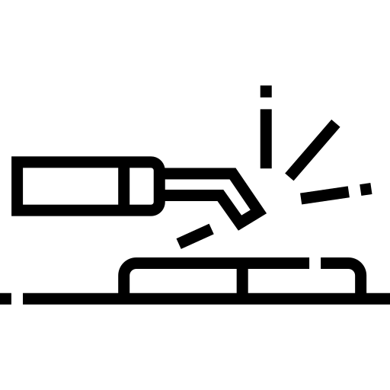
Our Past Work
Sound Analysis based AI model to monitor the quality of welding process
AI-driven welding solutions
Welding Data Collection for Intel
Systematically collect welding data for multiple welding defects and log accurate sensor parameters

Slide 3

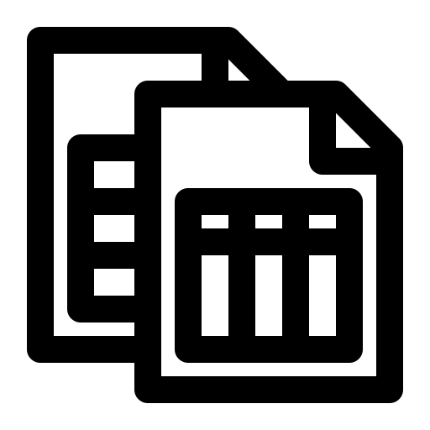
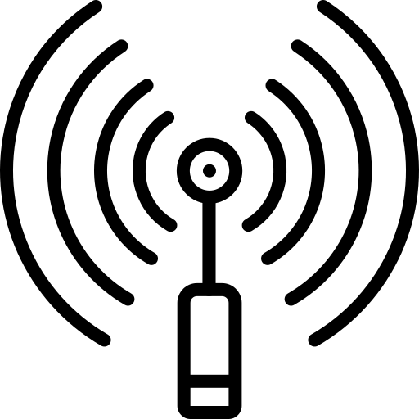
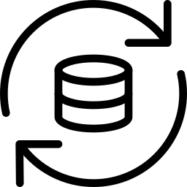
Welding Data Collection for Intel
Dataset Key Requirements
Sensor recordings requirements:
4-17 different defect types, and 20 samples per defect type, and 14 different combinations of welding parameters per defect time.
The minimum sample length will be 10cm
Data should be synchronized and autonomous:
Time synchronized so that the weld activities can be cross analyzed between the audio, video, and time-series modalities.
The data recording will be triggered in an automated fashion
Dataset should include data from 4 modalities:
Audio, Video and time-series of the welding machine parameters, and a color photograph for each welding sample.

Slide 4
Welding Data Collection for Intel
Data Annotation Requirements
Continue with the process
Inspect next lot / item for welding
Good Weld
Experiment Setup Information
Sensor Configuration
Classification of Weld
Document what weld defects were created
A natural language description on how the weld was created
If available, provide supporting testing data to confirm presence of defect
Defective Weld

Slide 5
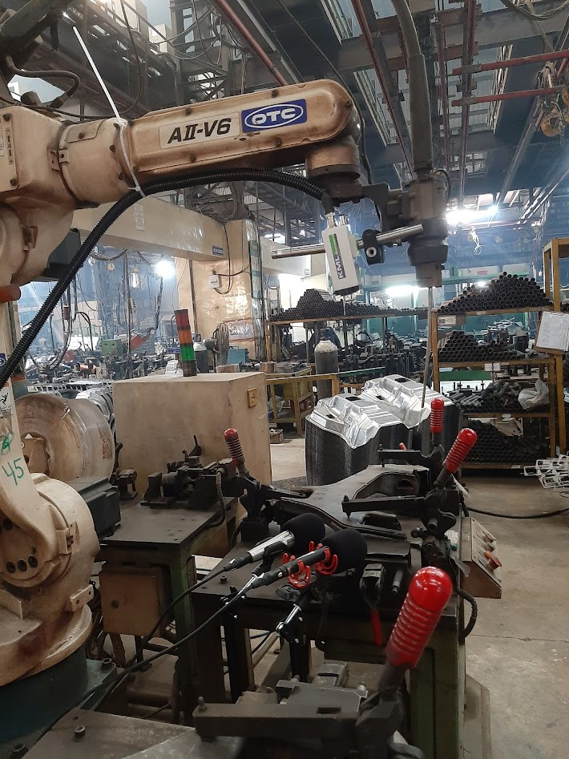
Welding Data Collection for Intel
Setup Details
Camera attached to Welding Robot neck
Microphones
(placed side to the welding plate)

Slide 6
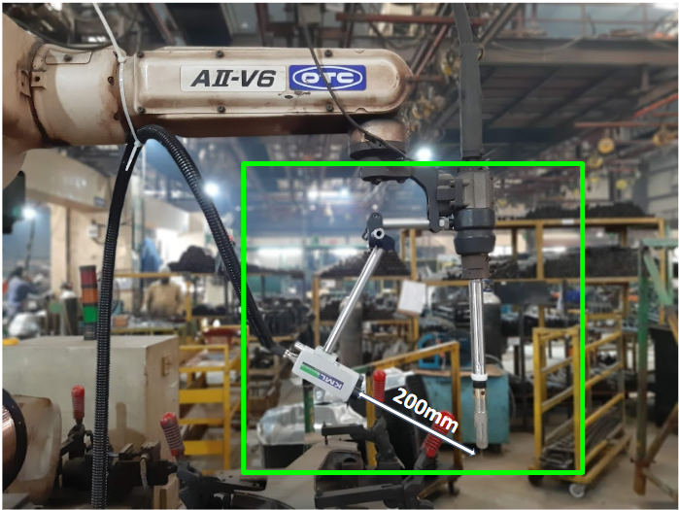
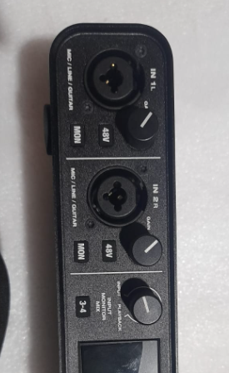
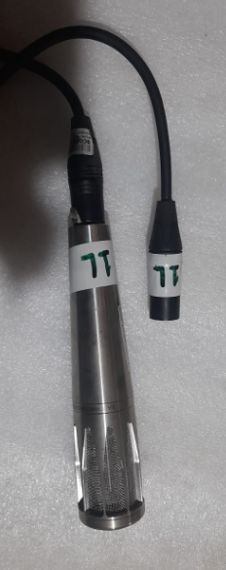
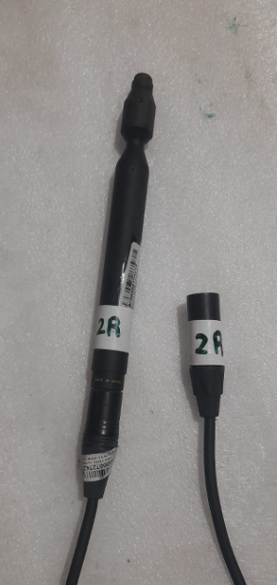
Welding Data Collection for Intel
Camera Setup and Microphone
Camera Mounting
Naming of the microphones with MOTU device

Slide 7
Thank You

